Slide 1
Exploratory Testing
Fundamentally different to other testing – about feel and coordination, not managing a suite of regression tests
Develop aims / charter
Manage a session
Log steps of tester
Record application response
Communicate with developers
Get feedback to inform future testing

Slide 2
Where exploratory testing tools can help
Develop aims / charter
Manage a session
Log steps of tester
Record application response
Communicate with developers
Get feedback to inform future testing
Quick creation of tests
Help record activity [eg screen recorder]
Quick and flexible editing of tests
filter things down to the main findings [eg video editing]
Actively alert the right people to review or take action [often not as formal as bug reports]
Help the tester track and follow-up on actions

Slide 3
Where can Spira 5.3 help
Develop aims / charter
Manage a session
Log steps of tester
Record application response
Communicate with developers
Get feedback to inform future testing
New exploratory test case type
On-the-fly editing (inc adding/removing test steps)
Rich-text editing and great screenshot capture
A simple way to log multiple discoveries from a single test step
Help the tester track the latest on their different discoveries
Dedicated exploratory testing experience for execution of a single exploratory test case

Slide 4
Potential areas for future development
Develop aims / charter
Manage a session
Log steps of tester
Record application response
Communicate with developers
Get feedback to inform future testing
Change internal nomenclature to reflect exploratory testing terminology
Integrate with tools like mind-maps for capturing a testing session
Record additional activity during testing (beyond screenshots)
Further integrations with internal IM
Improve notifications, offering more options and
Running an exploratory test set (an exploratory test case within a test set could be available for regression testing in 5.3)

Slide 5
Our Proposed Workflow For SpiraTeam 5.3
Develop aims / charter
Manage a session
Log steps of tester
Record application response
Communicate with developers
Get feedback to inform future testing
CREATE exploratory test case
EXECUTE the test case with new UI
EDIT everything on the fly
RECORD the test run status as normal
Get ALERTS when tasks have been closed
Create TASKS as light touch issues

Slide 6
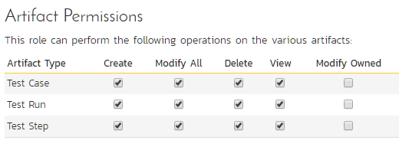
Ability to make / use exploratory test could be linked to permissions

Slide 7
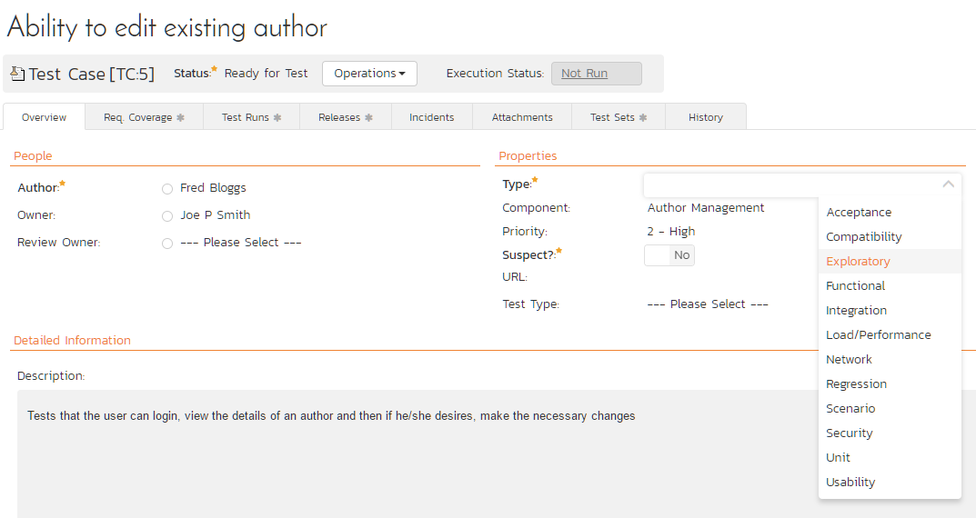

Slide 8
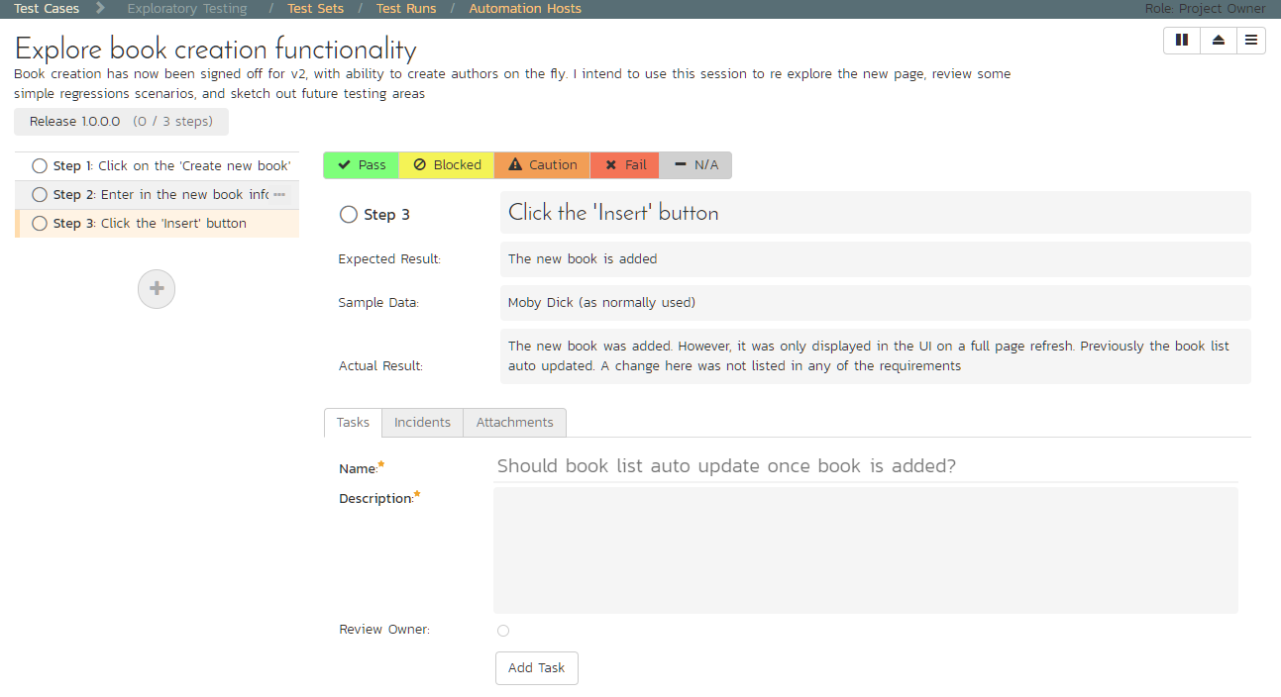

Slide 9
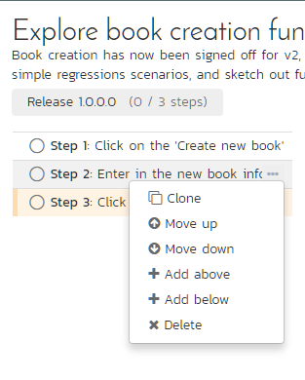

Slide 10
Technical questions
CREATE
EXECUTE
EDIT
RECORD
ALERTS
TASKS
Link to permissions?
Include sample data?
Any missing actions?
See actual result from last run?
See status from last run?
Link of actual result to tasks?
(1 to many or 1 to 1)?
When to test again?
(see below)

Slide 11
Other technical issues
CREATE
EXECUTE
EDIT
RECORD
ALERTS
TASKS
SpiraTeam only, or SpiraTest too but without tasks?
What options on finishing a test run?
E.G.: create new test case from run, update existing test case, do neither?
Should tasks be linked to both the test run and test case or just the test run?
Change the test case status when all tasks completed?
A progress bar of tasks on the Test Case list page?

